Slide 1
e-Challan Payment
An e-Challan App for the Police
TEAM AAVISHKARAK

Slide 2
Contents
TEAM AAVISHKARAK
Problem Statement
Solution
Features
Highlights
What do we solve?

Slide 3
SIH Problem Statement
TEAM AAVISHKARAK
Making Government payments Online

Slide 4
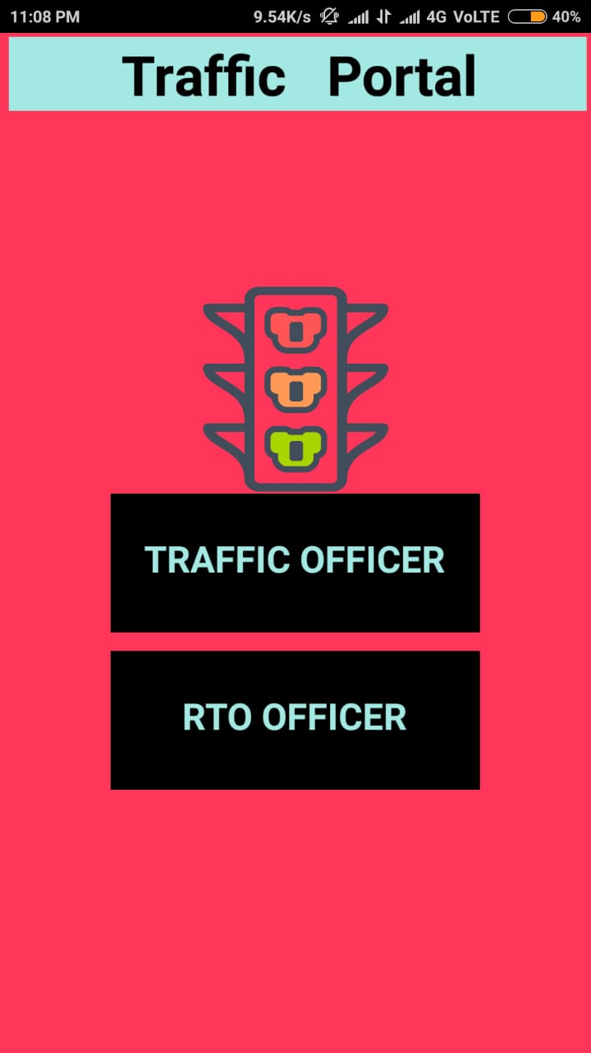
Solution
TEAM AAVISHKARAK
The users of the application would be the Government officials.
With a provided Login data, Traffic police officers would be able to log in and issue challans against the violator. The violator would be able to scan a QR code to pay the challan or could pay the challan directly through a window in our application. The generated receipt would be sent through a mail/sms to the violator. This will make issuing a challan easy and less hectic for the officers.

Slide 5
Features
TEAM AAVISHKARAK
Login & Signup
Issue new Challan
Select the violations through Checkboxes
Pay e-Challan
Request e-Challan through mail/SMS
e-Challan receipt through Mail/SMS
Maintained Database
Location & Time Tracking

Slide 6
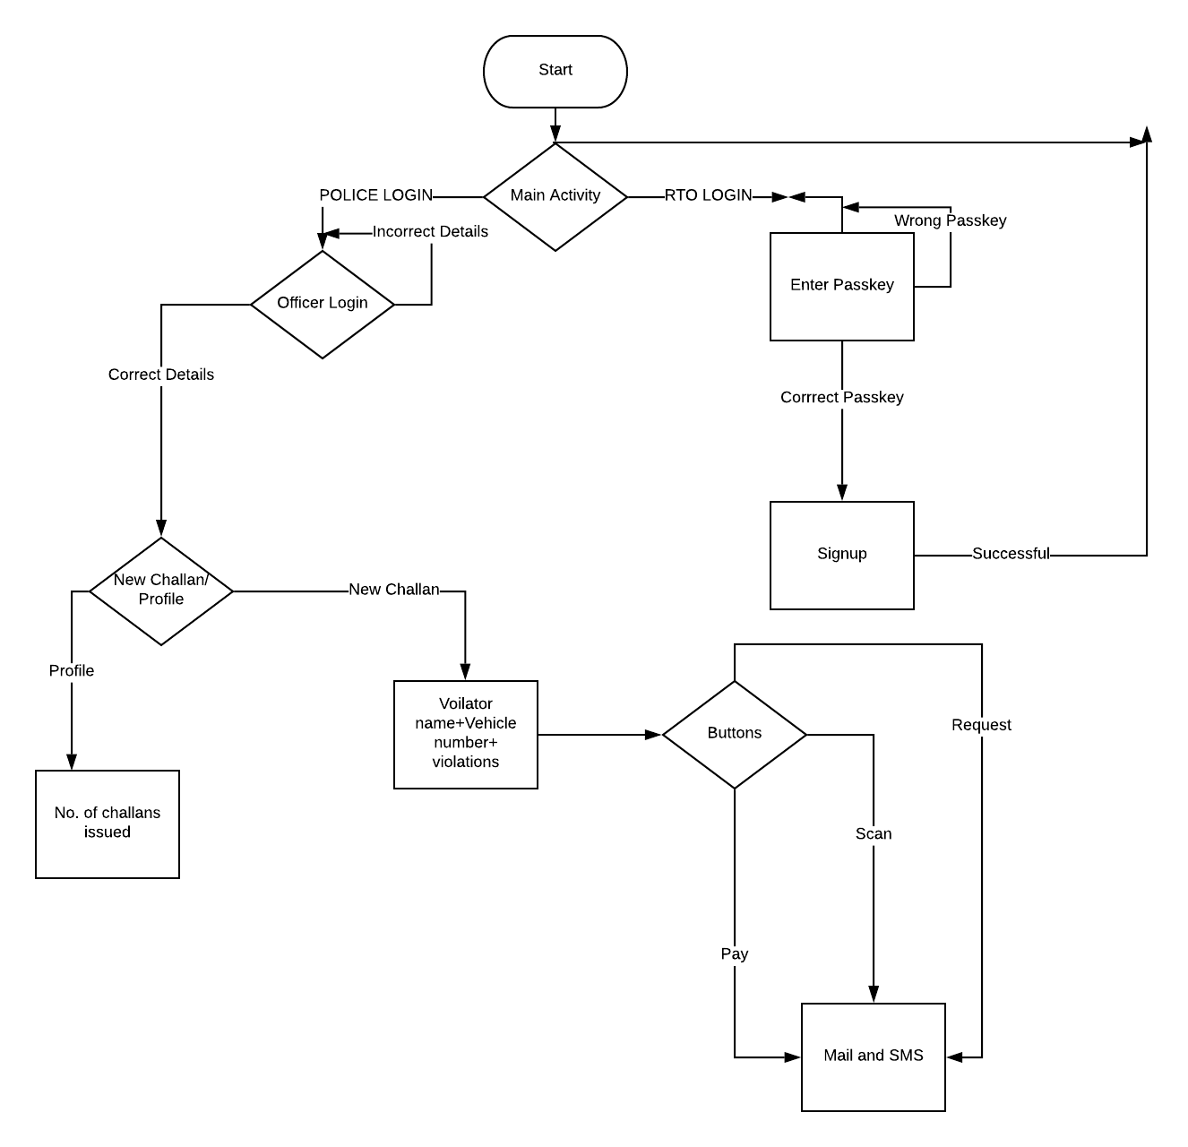

Slide 7
Thank You!
TEAM AAVISHKARAK

